Slide 1
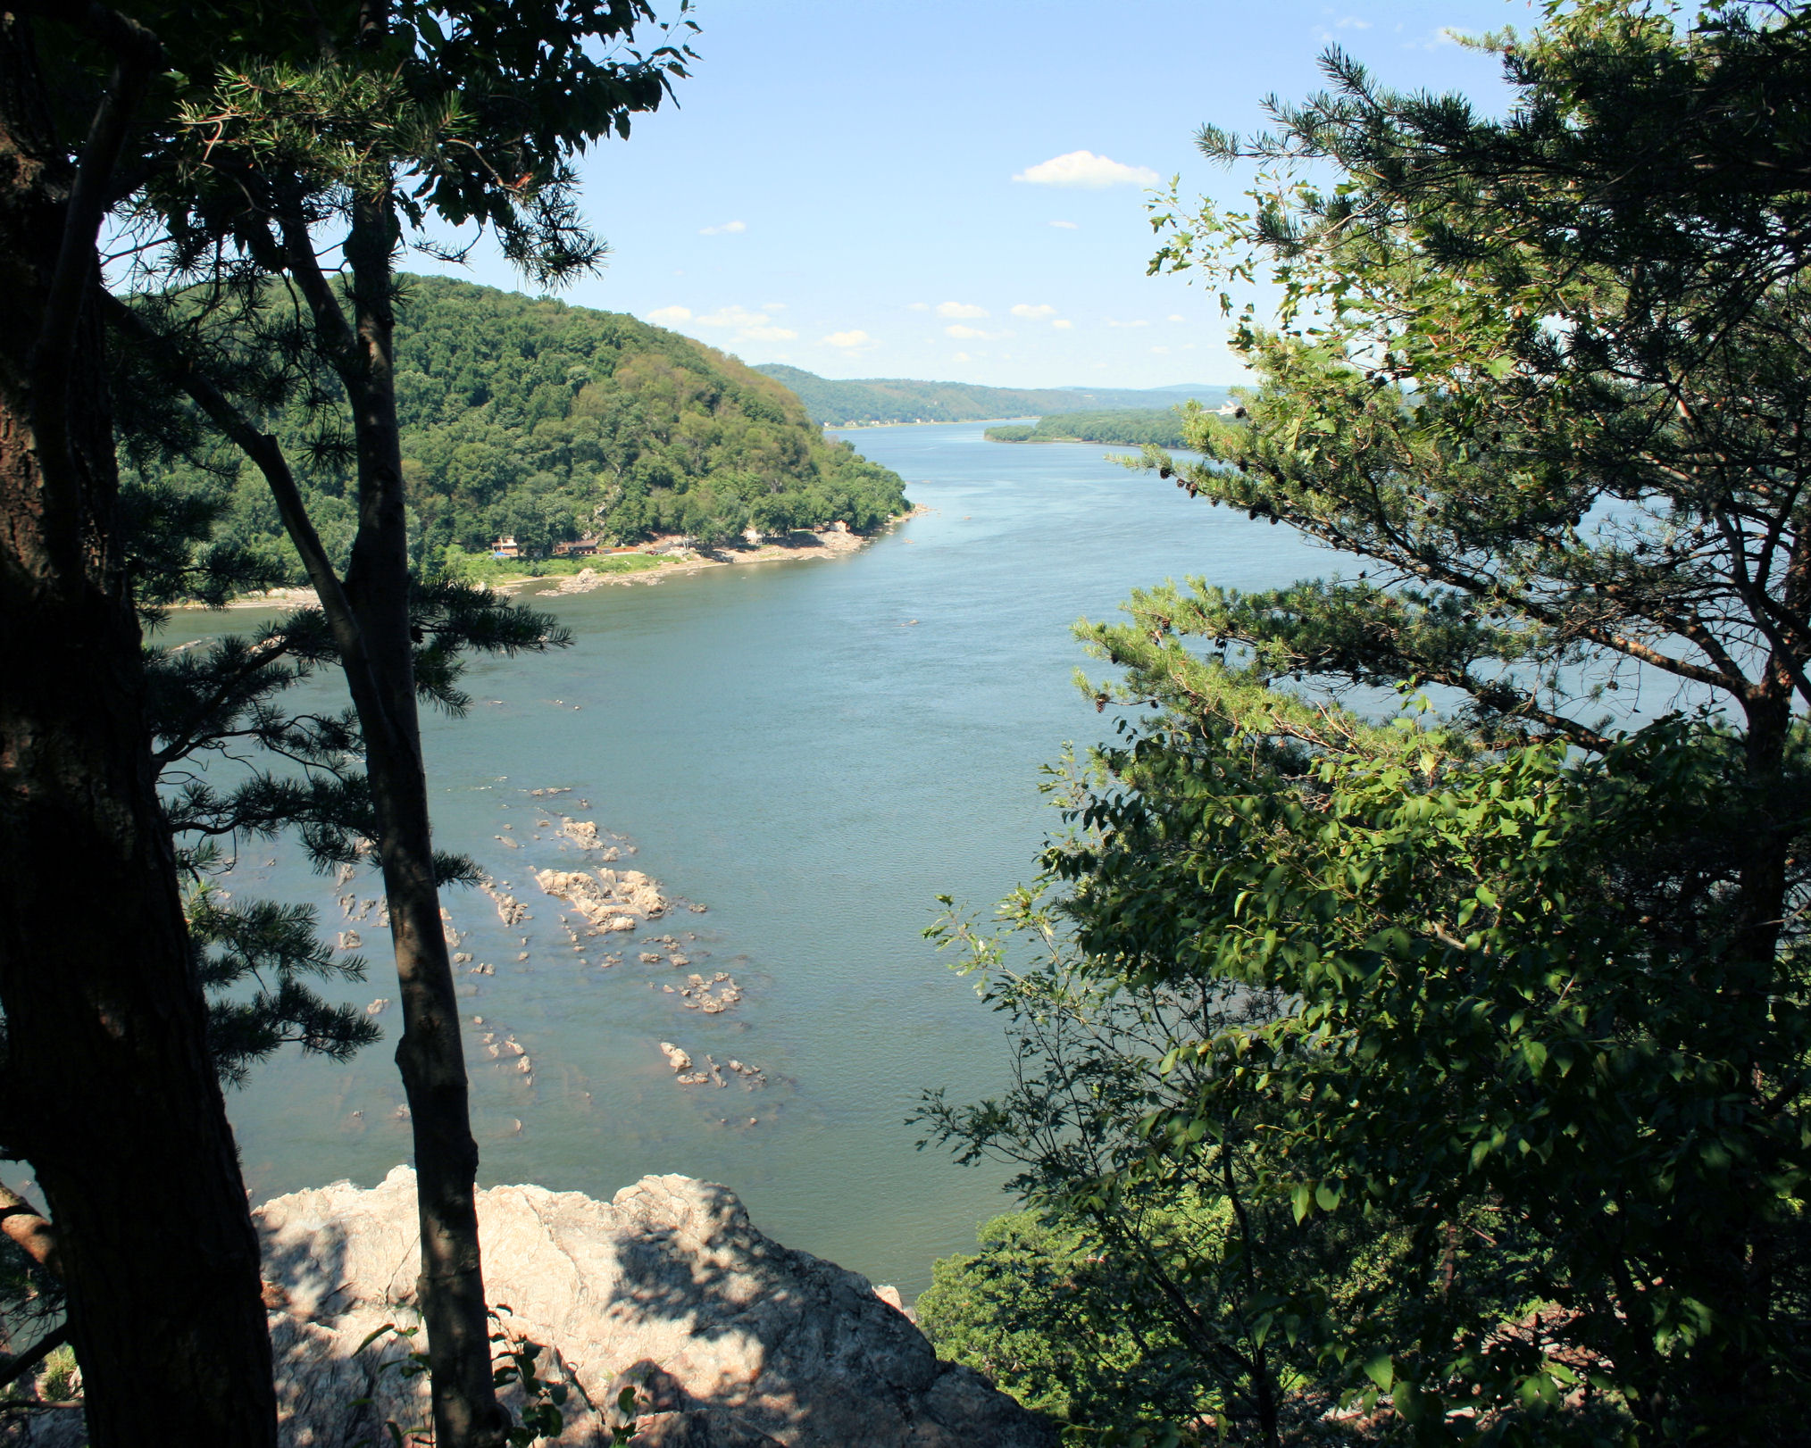
Susquehanna River photo from wilkes.edu

Slide 2
Indwelling of the Spirit
Romans 8.9 NIV: You [believers in Rome], however, are not in the realm of the flesh but are in the realm of the Spirit, if indeed the Spirit of God lives in you. And if anyone does not have the Spirit of Christ, they do not belong to Christ.

Slide 3
Indwelling of the Spirit
1 Corinthians 6.19 NET: Or do you not know that your body is the temple of the Holy Spirit who is in you, whom you have from God, and you are not your own?

Slide 4
Regenerating by the Spirit
John 1.12 [NET]: But to all who have received him [Christ] – those who believe in his name – he has given the right to become God's children…
John 3.3 [NASB]: [Jesus speaking] “Truly, truly, I say to you, unless one is born again he cannot see the kingdom of God.”

Slide 5
Regenerating by the Spirit
1 Peter 1.3 ESV: Blessed be the God and Father of our Lord Jesus Christ! According to his great mercy, he has caused us to be born again to a living hope through the resurrection of Jesus Christ from the dead…

Slide 6
Baptism in the Spirit
1 Corinthians 12.13 NET: For in one Spirit we were all baptized into one body. Whether Jews or Greeks or slaves or free, we were all made to drink of the one Spirit.

Slide 7
Baptism in the Spirit
Paul says “all the Corinthians were baptized in the Holy Spirit and the result was that they became members of the body of Christ… ‘Baptism in the Holy Spirit,’ therefore, must refer to the activity of the Holy Spirit at the beginning of the Christian life when he gives us new spiritual life (in regeneration) and cleanses us… In this way ‘baptism in the Holy Spirit’ refers to all that the Holy Spirit does at the beginning of our Christian lives.”
– Wayne Grudem, Systematic Theology

Slide 8
Baptism in the Spirit = Identification with Christ
Ephesians 1.13-14 NET: And when you heard the word of truth (the gospel of your salvation)– when you believed in Christ– you were marked with the seal of the promised Holy Spirit, who is the down payment of our inheritance, until the redemption of God's own possession, to the praise of his glory.

Slide 9
Baptism in the Spirit = Identification with Christ
As you come to faith in Christ, Christ baptizes you in the Holy Spirit, and thus the Holy Spirit comes to dwell inside you, to regenerate you spiritually, and to bring you into membership of the body of Christ, also known as the church.

Slide 10
John’s Water Baptism
Matthew 3.1-2, 5-6 NET: In those days John the Baptist came into the wilderness of Judea proclaiming, ‘Repent, for the kingdom of heaven is near’ … Then people from Jerusalem, as well as all Judea and all the region around the Jordan, were going out to him, and he was baptizing them in the Jordan River as they confessed their sins.

Slide 11
John’s Water Baptism
1 John 1.9-10 NET: But if we confess our sins, he is faithful and righteous, forgiving us our sins and cleansing us from all unrighteousness. If we say we have not sinned, we make him [out to be] a liar and his word is not in us.

Slide 12
Believers’ Water Baptism
Matthew 28.18-20 NET: Then Jesus came up and said to them, ‘All authority in heaven and on earth has been given to me. Therefore go and make disciples of all nations, baptizing them in the name of the Father and the Son and the Holy Spirit, teaching them to obey everything I have commanded you. And remember, I am with you always, to the end of the age.’

Slide 13
Believers’ Water Baptism = Confession of Faith
Matthew 28.18-20 NET: Then Jesus came up and said to them, ‘All authority in heaven and on earth has been given to me. Therefore go and make disciples of all nations, baptizing them in the name of the Father and the Son and the Holy Spirit, teaching them to obey everything I have commanded you. And remember, I am with you always, to the end of the age.’

Slide 14
Believers’ Water Baptism: Unity with Christ
Romans 6.1-10 NET: What shall we say then? Are we to remain in sin so that grace may increase? Absolutely not! How can we who died to sin still live in it? Or do you not know that as many as were baptized into Christ Jesus were baptized into his death? Therefore we have been buried with him through baptism into death, in order that just as Christ was raised from the dead through the glory of the Father, so we too may live a new life. For if we have become united with him in the likeness of his death, we will certainly also be united in the likeness of his resurrection.

Slide 15
Believers’ Water Baptism: Unity with Christ
Romans 6.1-10 NET [continued]: We know that our old man [our old way of living] was crucified with him so that the body of sin would no longer dominate us, so that we would no longer be enslaved to sin. (For someone who has died has been freed from sin.) Now if we died with Christ, we believe that we will also live with him. We know that since Christ has been raised from the dead, he is never going to die again; death no longer has mastery over him. For the death he died, he died to sin once for all, but the life he lives, he lives to God.

Slide 16
Believers’ Water Baptism = Commitment to Obey
1 Peter 3.21 NASB: Corresponding to that [the waters of Noah’s Ark], baptism now saves you-- not the removal of dirt from the flesh, but an appeal to God for a good conscience-- through the resurrection of Jesus Christ…

Slide 17
Believers’ Water Baptism: Unity with Each Other
Ephesians 4.4-6 NET: There is one body and one Spirit, just as you too were called to the one hope of your calling, one Lord, one faith, one baptism, one God and Father of all, who is over all and through all and in all.
Galatians 3.26-28 NET: For in Christ Jesus you are all sons of God through faith. For all of you who were baptized into Christ have clothed yourselves with Christ. There is neither Jew nor Greek, there is neither slave nor free, there is neither male nor female– for all of you are one in Christ Jesus.

Slide 19
Application
1. Put your faith in Christ and receive the blessing of baptism in the Holy Spirit.
2. Receive the blessing of baptism in water.
3. Confess and repent of your sins regularly.
4. Join a local church.

